Slide 1


STRATEGIC
DEAL INTELLIGENCE ASSISTANT
Agentic AI Engineering Walkthrough
Grounded
Permission-Aware
Observable
Human-Approved
Oded Goldberg
Candidate — Agentic AI Engineer

Slide 2



















FROM FRAGMENTED CONTEXT TO DECISION SUPPORT
The challenge is not missing data. It is disconnected context.
Salesforce
STRATEGIC DEAL INTELLIGENCE BRIEF
Gong calls
Deal state
Buyer goals
Stakeholders
Negotiation risks
Recommended next actions
Missing information
Supporting evidence
Slack updates
Pricing notes
Deal Desk policy
Faster preparation. Better grounding. Safer decisions.

Slide 3



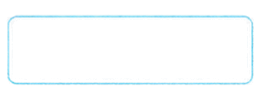





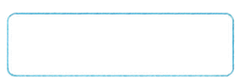






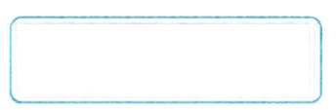





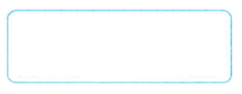








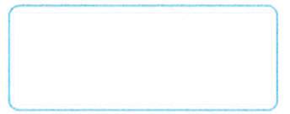






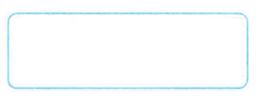












LOCAL PROTOTYPE ARCHITECTURE
A governed agent workflow around live LLM reasoning
User / CLI / Demo UI
Local Config . env
API Keys - Settings
CORE PRINCIPLES
Local Application Service
LangGraph Orchestration
Typed State - Pydantic Contracts
Local Logs
Logs - Metrics
01
Authorization Before Retriev
Authorization Gate
Unauthorized
Access Denied
→ End
Authorized - Authorized
Trace Files
Run Traces
Qdrant
Evidence
Vector Store
Governed Retriev
BM25 + Dense + RFF
Permission + Metadata Filters
02
Specialized Agents
Local State Store
Approvals - Checkpoints - Run Metadata
Deal Context
Agent
Conversation Intelligence
Agent
Stakeholder Map
Agent
03
Human Approval
for Sensitive Actions
Local Files
Source Documents - Generated Briefs - Run Artifacts
Negotiation Strategy Agent
04
Citation + Policy Validation
↓ Risk Check
Live LLM Provider
LLM Reasoning / Agent Calls
Observable by Design Metrics • Traces • Audit Trail
Sensitive
Normal
Human-in-the-Loop
Approval
Strategic Deal
Intelligence Brief
Strategic Deal
Intelligence Brief
DETERMINISTIC CONTROL
AI JUDGMENT

Slide 4


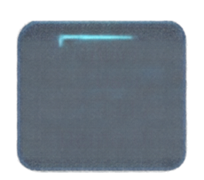

























AUTHORIZATION BEFORE EVIDENCE REACHES THE MODEL
Security is enforced before retrieval — not delegated to the prompt.
SECURITY PRINCIPLES
ENFORCE BEFORE RETRIEVAL
Authorization Before Retrieval
ALLOW
RETRIEVE PERMITTED EVIDENCE
User /
CLI /
Demo UI
AUTHORIZATION CHECK
Permission Aware Filtering
DENY
BUILD MODEL CONTEXT WITH PERMITTED DATA
User • Opportunity • Source • Metadata
Unauthorized Restricted Data Never Enters Model Context
TERMINATE
NO RETRIEVAL
NO CONTEXT
GENERATE RESPONSE
Clean Denial • No Partial Answer
AUTHORIZATION IS A CODE-LEVEL SECURITY BOUNDARY, NOT A PROMPT INSTRUCTION.

Slide 5

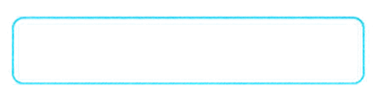


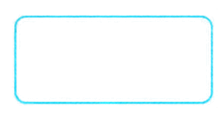
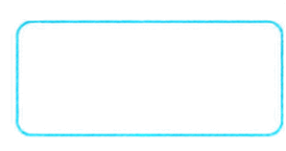
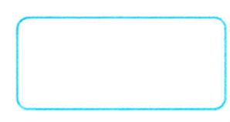


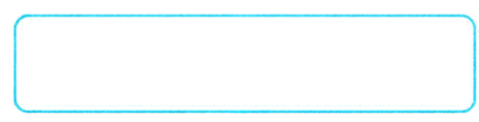


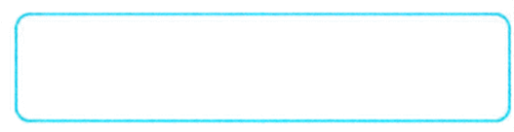



SPECIALIZED AGENTS
ONE STRATEGIC BRIEF
Focused responsibilities make reasoning easier to control, validate and evaluate.
Deal Context Agent
Governed Evidence
01
Canonical CRM facts
Opportunity • Stage • Amount • Close Date • Owner
Deal Context Agent
Conversation
Agent
Stakeholder Map Agent
02
Conversation Intelligence Agent
Goals • Objections • Urgency • Competitors • Action Items
Stakeholder Map Agent
Negotiation Strategy Agent
03
Economic Buyer • Champion • Blockers • Procurement • Unknowns
Validation + Risk Check
Negotiation Strategy Agent
04
Prioritized Next Actions • Owners • Rationale
STRATEGIC DEAL BRIEF

Slide 6

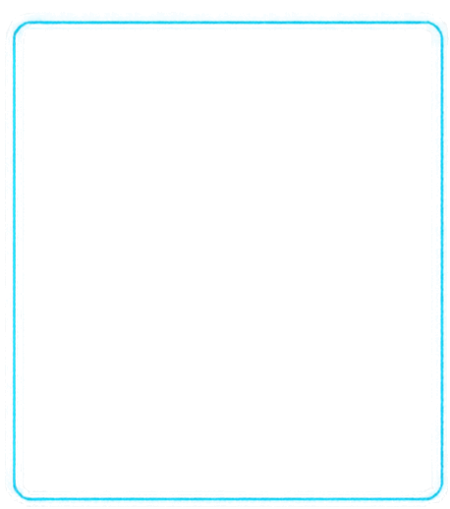
















EVALUATION — CAN I TRUST THE BEHAVIOR?
I evaluate the system around business critical failure modes, not only answer quality.
ACCESS CONTROL
GROUNDING
RETRIEVER
BEHAVIOR REGRESSION
Unauthorized request
Important claims
Relevant evidence survives hybrid retrieval
Golden scenarios remain stable across changes
restricted evidence
Validated against retrieved evidence
Slack evidence • conflicts • sensitive actions • injection cases
BM25 + Dense + RAF
Golden Tests
Unauthorized Leakage
Citation Validation
Required Slack Evidence
FINAL RUN RESULTS
7 synthetic updates indexed Slack citations verified
10/10 passed
0 retricted evidence leaked
10/10 citations validated
A CONVINCING 11M RESPONSE IS INSUFFICIENT — CRITICAL SYSTEM BEHAVIOR MUST BE MEASURABLE AND REGRESSION-TESTED.

Slide 7









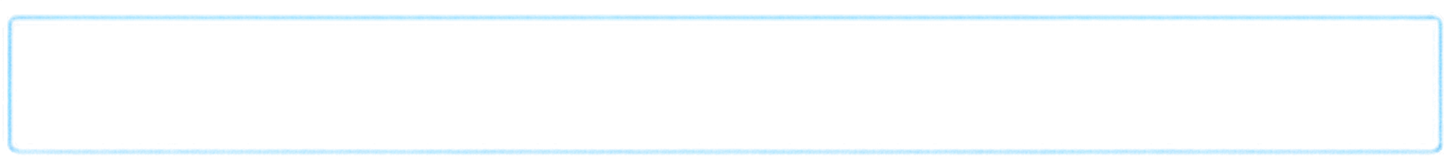





































WHAT BREAKS IN PRODUCTION?
The prototype validates the workflow. Production adds a durable data plane, incremental ingest, security, and operational scale.
PROTOTYPE
PRODUCTION EVOLUTION
CURRENT / LOCAL RUNNABLE PROTOTYPE
FUTURE / PROPOSED
Local single-process application
Data Ingestion
Connectors, webhooks, polling, SQS/EventBridge
Local Qdrant index
Index Lifecycle
Incremental upsets, deletes, replay, idempotency
Local workflow state
Freshness & History
Hot index for recent data, archive for historical search
Local run artifacts
Durable State
PostgreSQL workflow state, approvals, ingest checkpoints
Static file ingest
Security
API authentication, IAM, secrets management;
tenant isolation
Single application instance
Availability & Scale
Retries, timeouts, rate limits, dead-letter queues
Live LLM provider
Observability
Centralized logs, metrics, traces, alerts,
multi-worker capacity planning
PostgreSQL
1
ONLINE REQUEST PATH
API Gateway
ECS / Fargate API
2
Workflow Orchestrator
Qdrant – Filtered retrieval
User
Authorization + Agents
Bedrock /OpenAI
2
SHARED PLATFORM SERVICES
Secrets Manager
CloudWatch / OpenTelemetry
logs, metrics, traces, alerts
Qdrant
Hot Search Index
3
DATA INGESTION PATH
Connectors /
Webhooks / Polling
SQS / EventBridge
Ingestion Workers
Salesforce / Gong / Slack / Pricing APIs
S3 Raw Archive + Replay
RISK:
A local snapshot is not a production data platform. Without incremental ingestion, durable state, replay, and authorization-aware indexing, freshness and concurrency fail at scale.

Slide 8




















LIVE DEMO — THREE REQUESTS, THREE DELIBERATE OUTCOMES
AUTHORIZED STANDARD DEAL
Expected Outcome:
01
USR-5001 → OPP-1001
GROUNDED BRIEF
Show:
Brief Generation
Retrieved Evidence
Citations
Recommended Next Actions
AUTHORIZED RESTRICTED DEAL
Expected Outcome:
02
USR-5003 → OPP-1003
HUMAN REVIEW REQUIRED
Show:
Restricted Evidence
Sensitive Recommendation
Approval Flow
UNAUTHORIZED REQUEST
Expected Outcome:
03
USR-5007 → OPP-1003
DENIED BEFORE RETRIEVAL
Show:
Authorization Failure
Authorization Failure
PROOF OF MULTI-SOURCE GROUNDING
Generated Slack Update
Retrieved Evidence
Cited Finding in the Brief

Slide 9
QUESTIONS?

